Slide 1
CAREER MITRA
(Advanced Career Guidance System)
Government College of Engineering, Yavatmal
Final Year | Dept. of Computer Engineering
Project Presentation
Bhavesh S. Karnewar | T20101212450009
Shreyash P. Purankar | T20101212450032
Siddhant B. Jagtap | T20101212450056
Prem S. Borkar | T20101212450059
Guided By : Prof. Dhiraj D. Shirbhate

Slide 2
Introduction
Career Mitra helps us to reflect on our interests, ambitions, abilities, qualifications, etc. It helps us to understand the product market and education system and relate this to how we know about ourselves. Overall, Career Mitra trying to teach us to plan and make decisions about work and learning. Career Mitra is given to us information about the product market and about educational opportunities more accessible by organizing it, systematizing it, and making it available when and where we need it.

Slide 3
2. Problem Statement
Choosing a career path after 10th and 12th grade can be overwhelming. Existing resources often lack personalization and up-to-date information, leaving students confused and unsure. Accessibility issues further disadvantage some students, while a lack of engaging features hinders long-term career development. This highlights the need for a more robust and accessible career guidance system to empower students to make informed decisions about their future.

Slide 4
3. Methodology
Requirement Analysis
System Design
Database Design
Implementation
Testing
Deployment
User Training and Documentation
Continuous Improvement
By following this methodology, we aim to develop an advanced career guidance system that meets the requirements of organizations, providing them with a robust platform for finding the right career.

Slide 5
4. System Requirements
Hardware Requirements
Disk: Capacity >500MB for smooth performance
RAM: 2GB (minimum) and above.
Processor: Intel Core 2 Quad or Intel i3-5th Gen and above (recommended)
Software Requirements
OS: Mac, Windows 7 and above or linux.
Front End Technology: HTML5 CSS3, JavaScript.
Backend Technology: PHP & MySql
Code Editor: Visual Studio Code, Notepad or Other Code Editor
Web Browser: Google Chrome, Mozilla Firefox, Opera or Other Web Browser

Slide 6
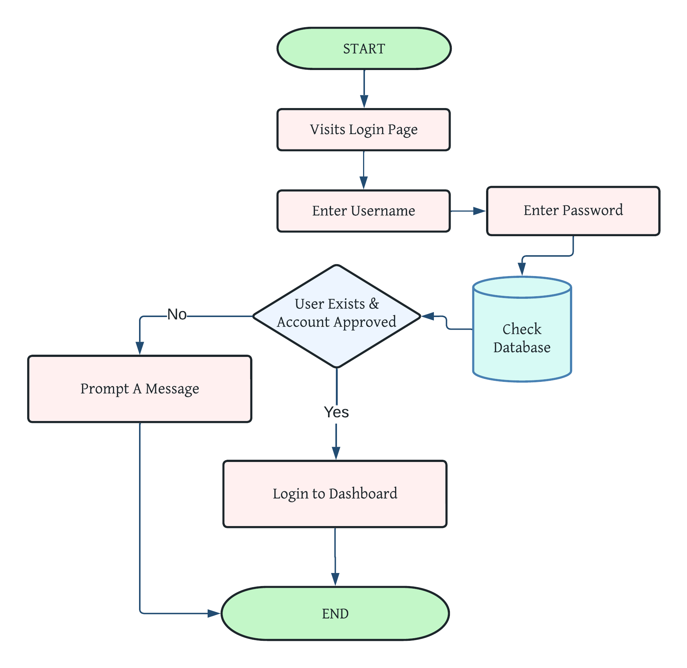
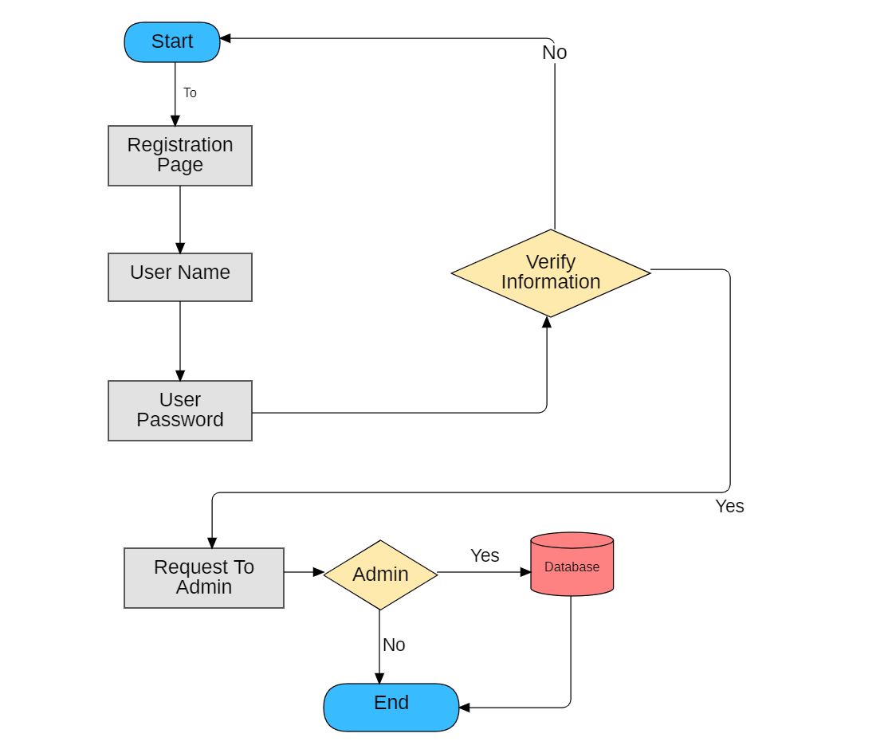
5. Project Architecture

Slide 7
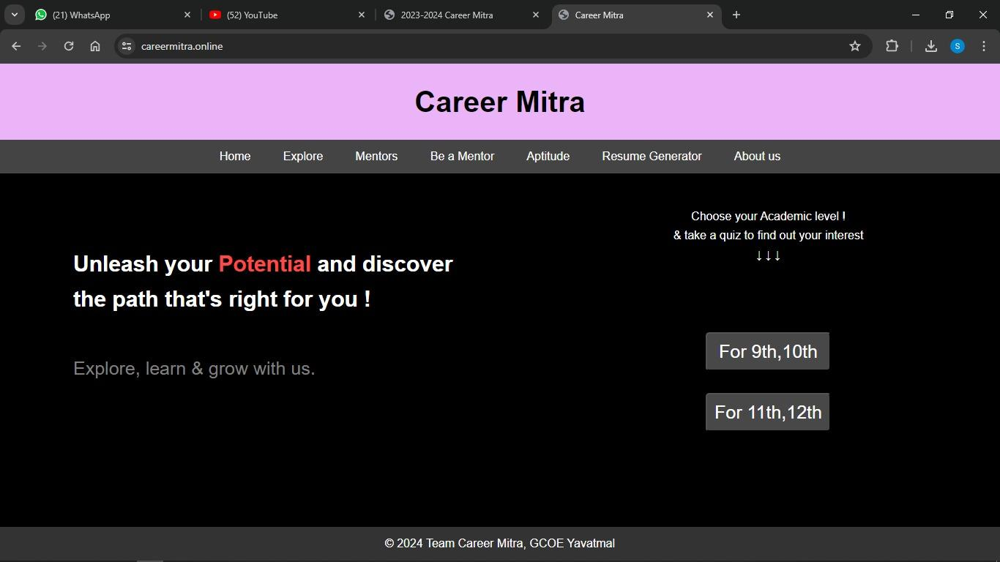
6. Project Implementation

Slide 8
7. Result & Output
Career Mitra offer a treasure trove of benefits for those navigating their careers. By taking assessments and exploring resources, users gain valuable self-awareness, discover potential career paths, and make informed decisions about their education and training. This can lead to a better fit in the job market, improved decision-making, and ultimately, a more fulfilling and successful career.
Project Output
Shows Score for SSC quiz
Shows Score for HSC quiz
Downloadable Resume in PDF Format

Slide 9
Conclusion
The main aim of the project is to make students understand their strengths, personality and skills. With the help of a Career Mitra system, students can choose a career path by directly interacting with the online counsellor. Also, it will help them to follow their interest. This system lends a helping hand to 10th as well as 12th standard students. 10th standard students would be able to choose suitable streams for themselves. 12th standard students can select suitable fields of their choice. This process not only depends on career experts, but information that is provided by parents and their children. This process is also very important and helpful to build up children's careers

Slide 10
Thank You !
Any questions?

